Slide 1
Syllabus Management
Western Oklahoma State College

Slide 2
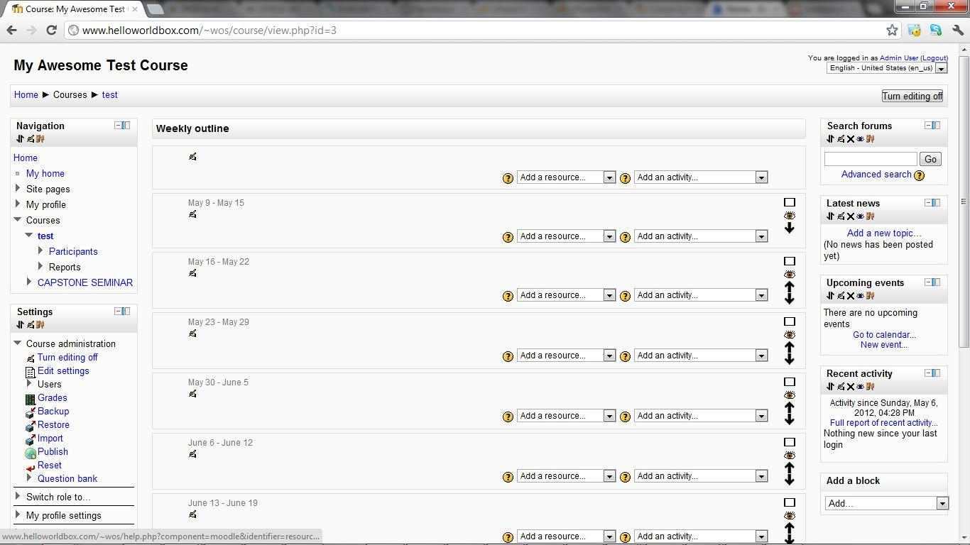
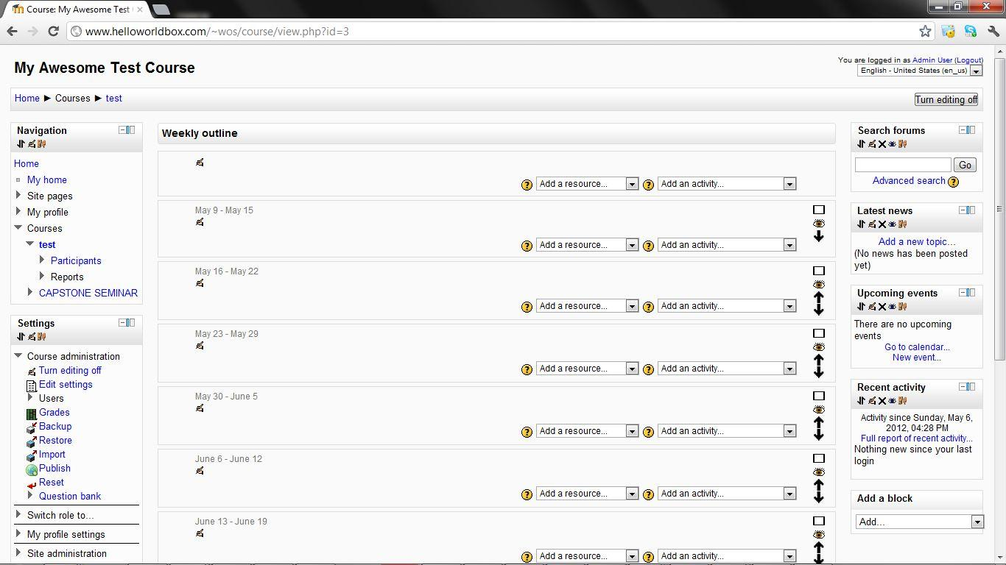
Step 1: Create a course

Slide 3
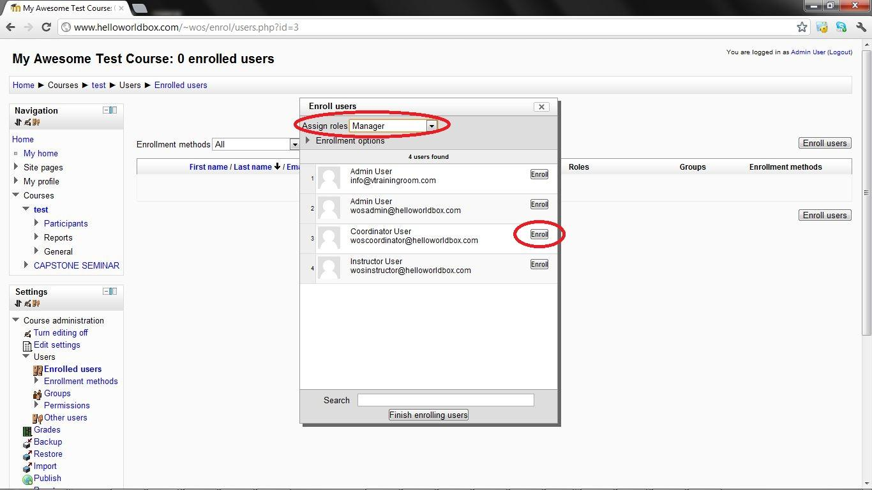
Step 2: Add a coordinator

Slide 4
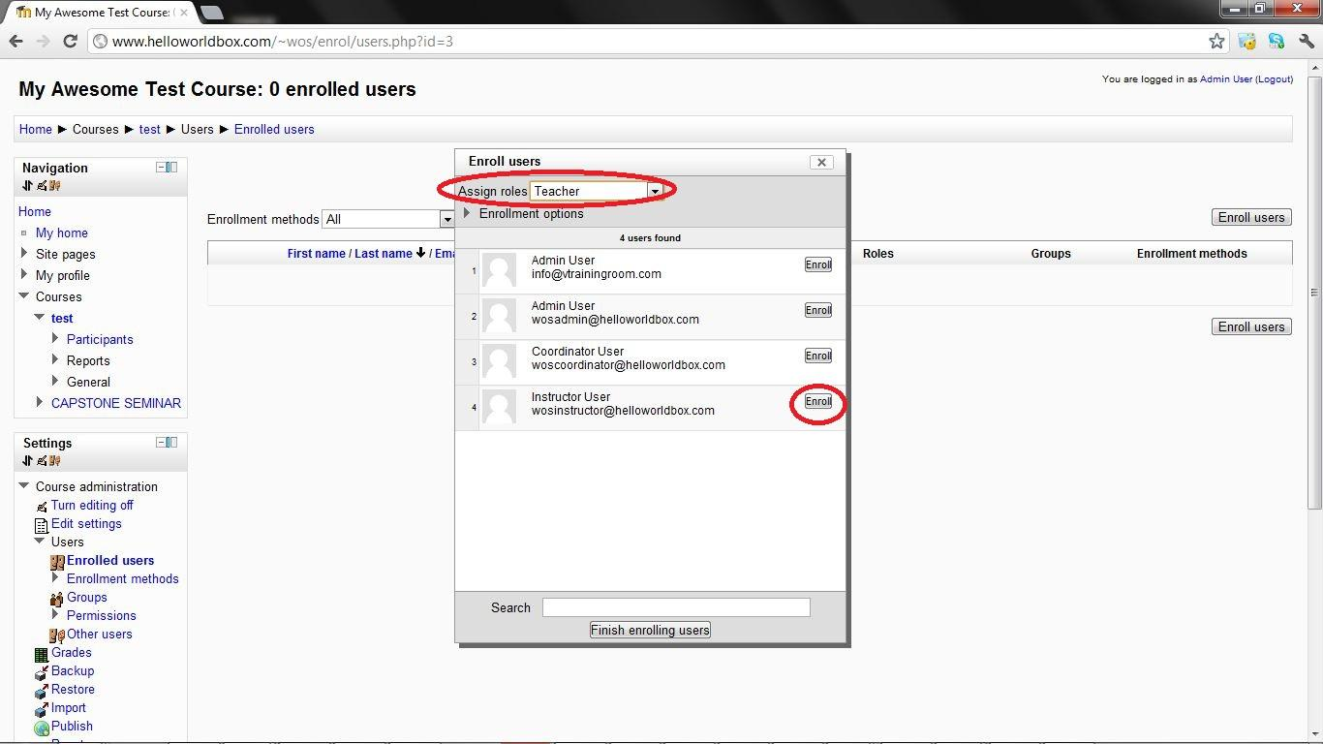
Step 3: Add an instructor

Slide 5
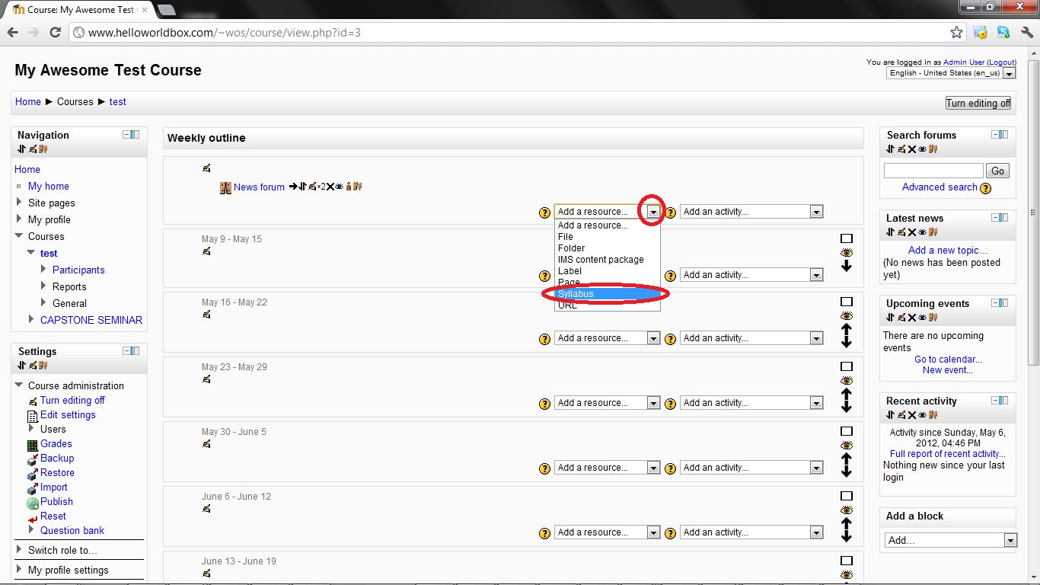
Step 4: Add a syllabus resource

Slide 6
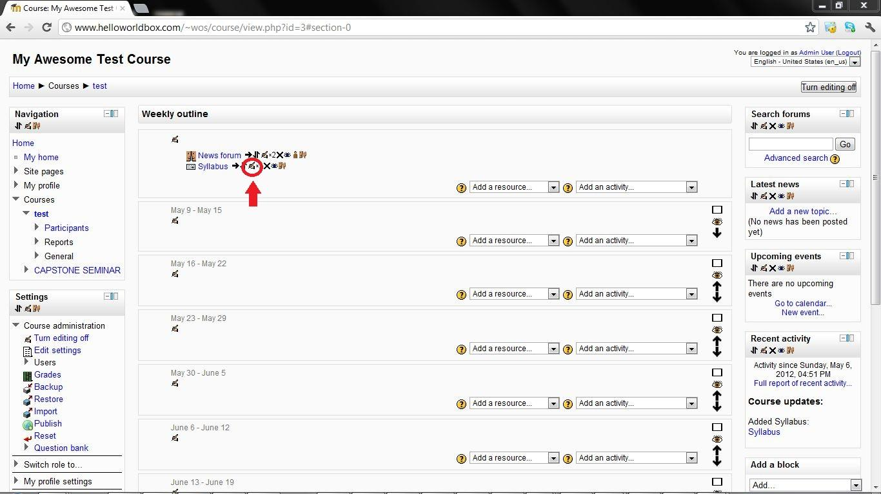
Step 5: Add a master syllabus

Slide 7
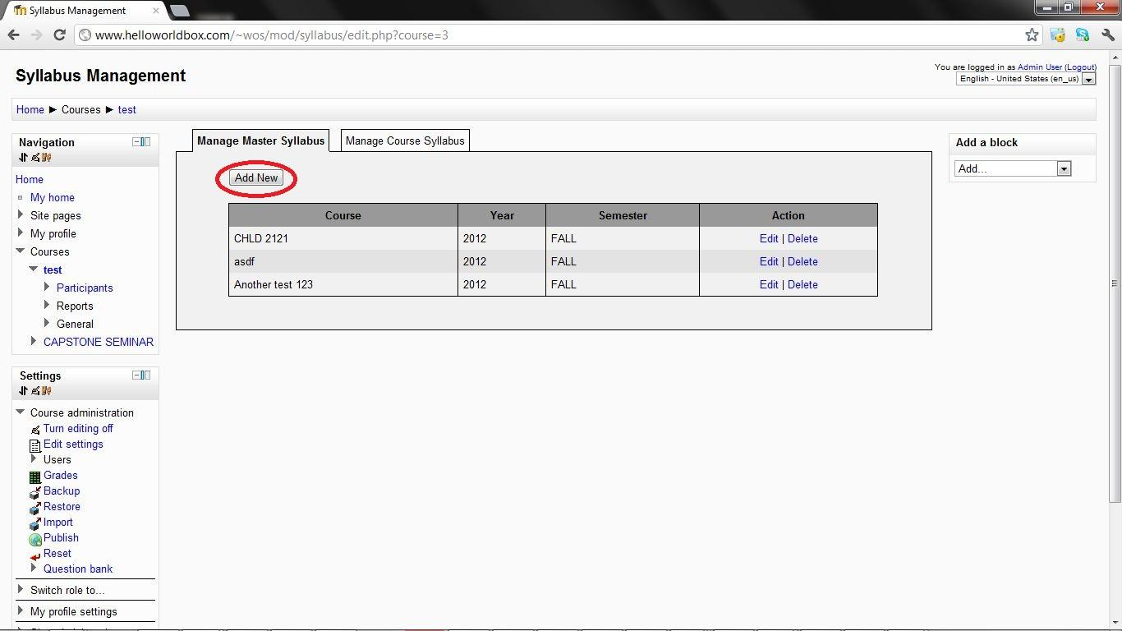
Step 5 cont'd

Slide 8
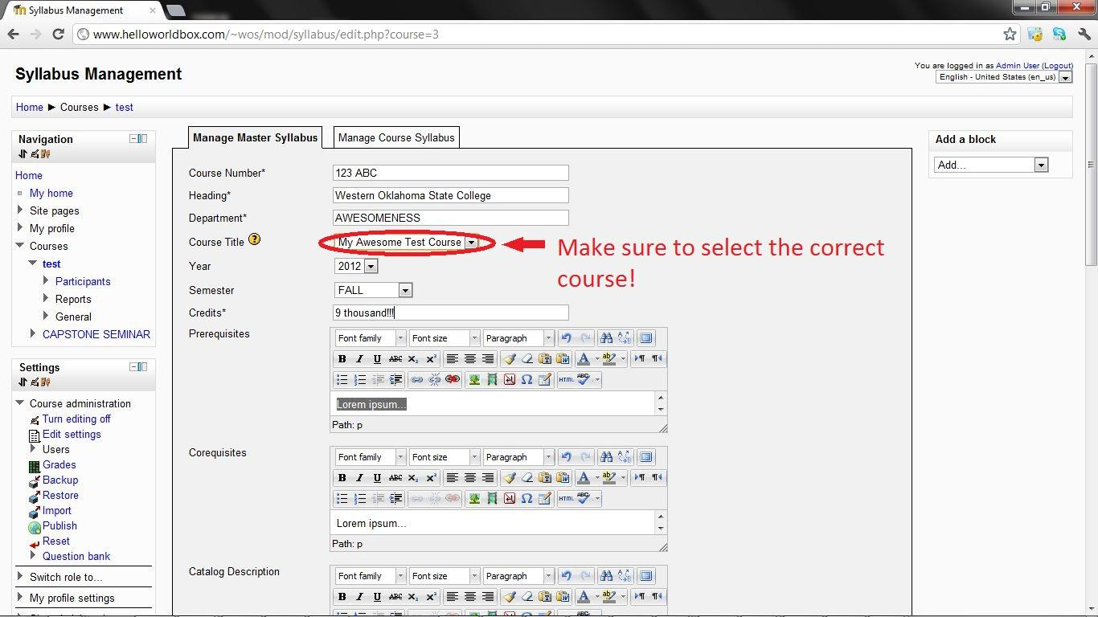
Step 5 cont'd

Slide 9
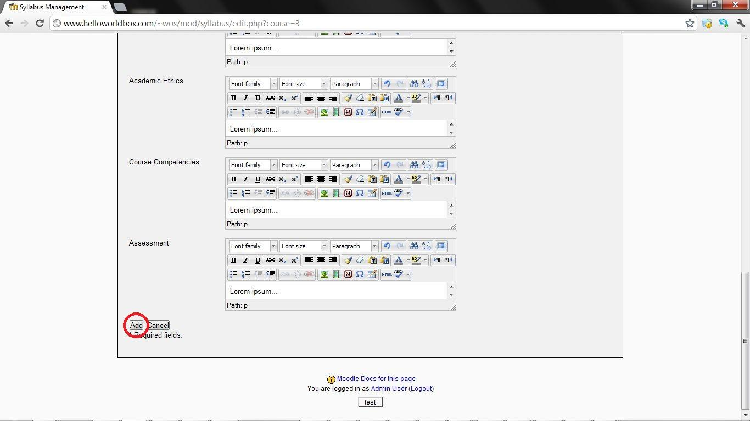
Step 5 cont'd

Slide 10
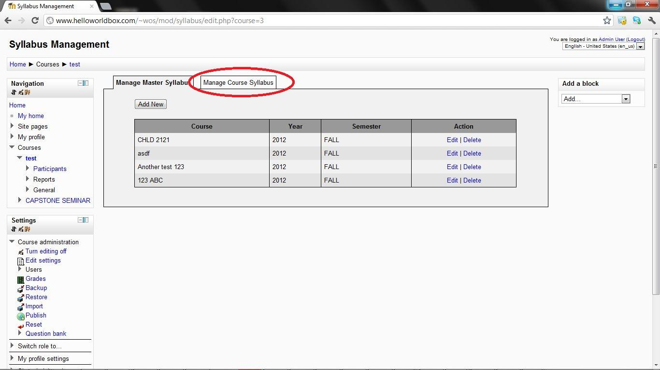
Step 6: Add the course syllabus

Slide 11
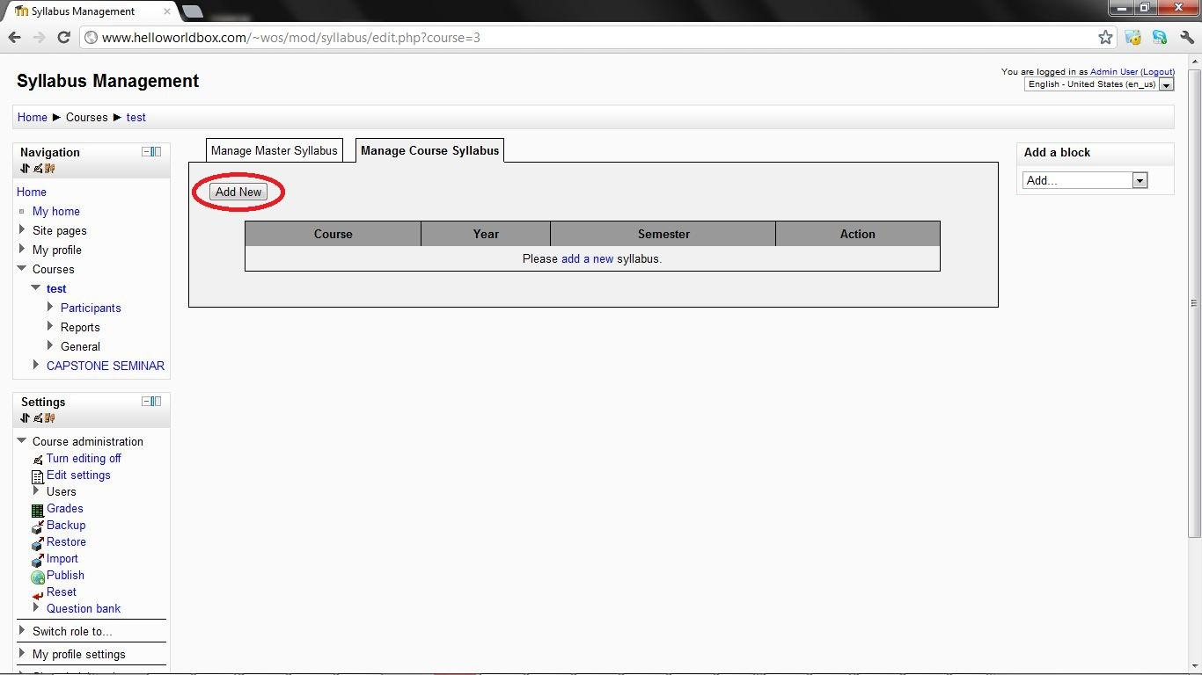
Step 6 cont'd

Slide 12
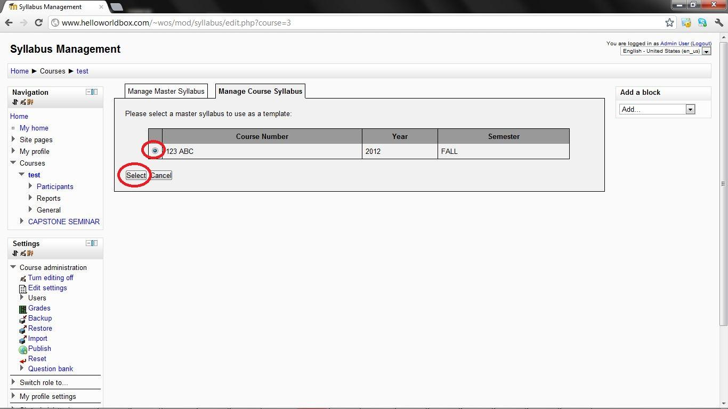
Step 6 cont'd

Slide 13
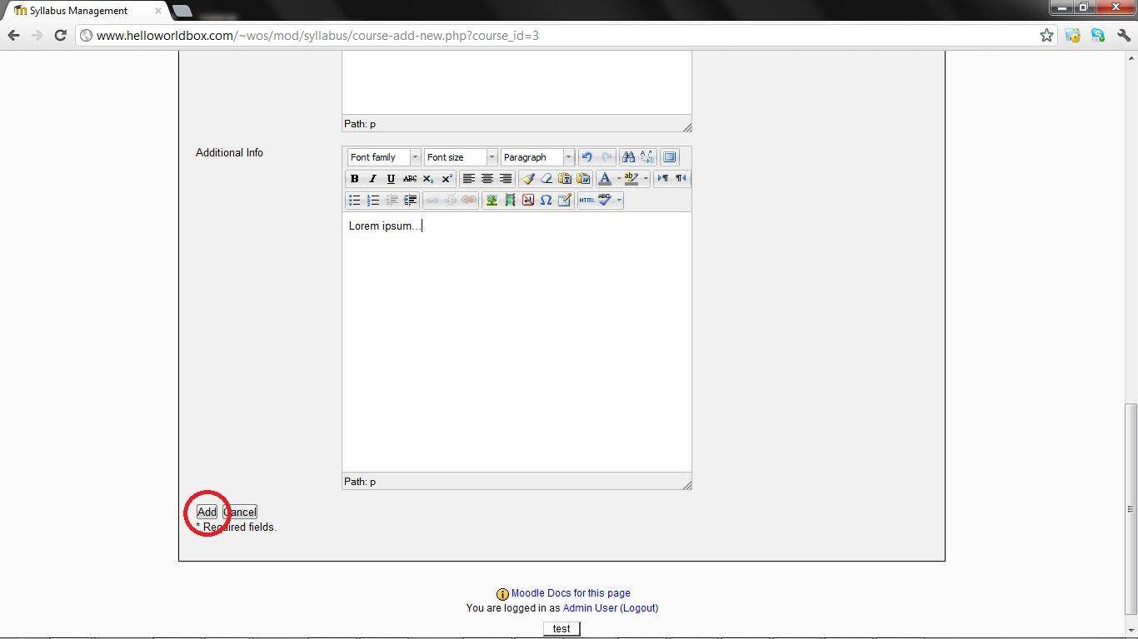
Step 6 cont'd

Slide 14
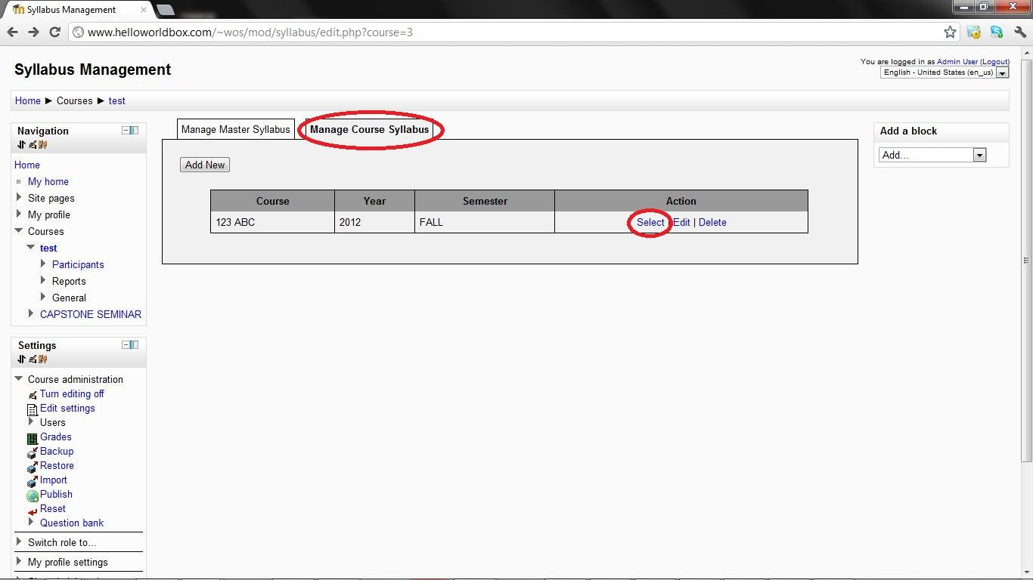
Step 7: Select the syllabus

Slide 15
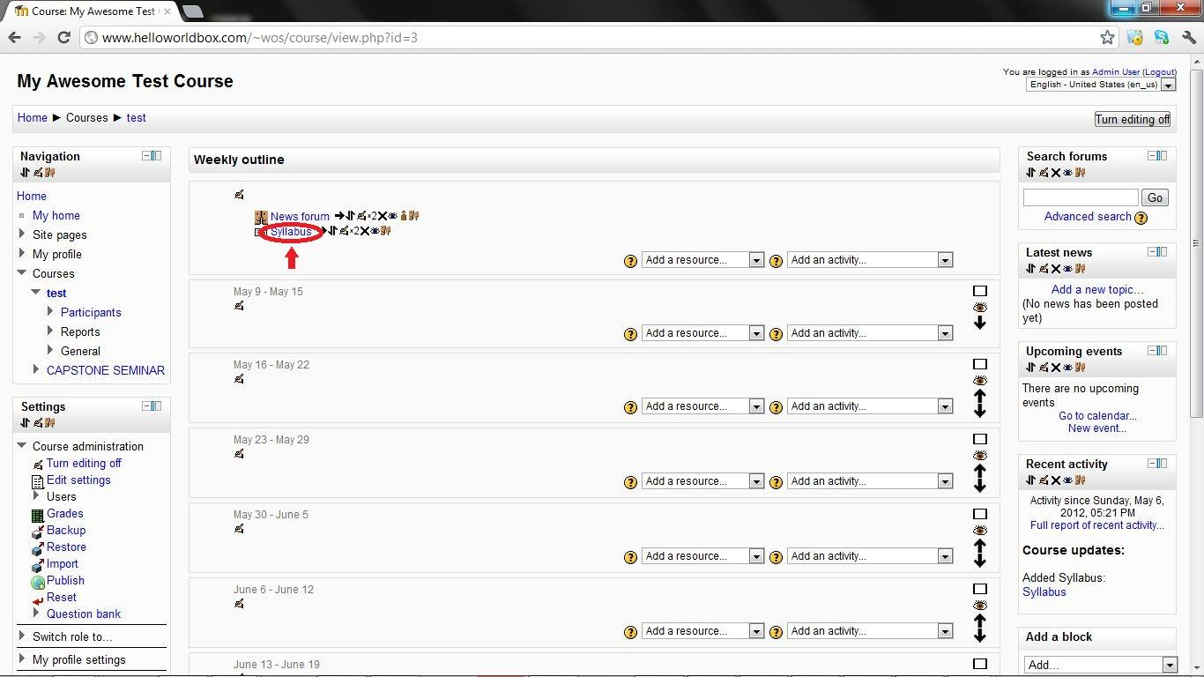
Step 8: View the syllabus

Slide 16
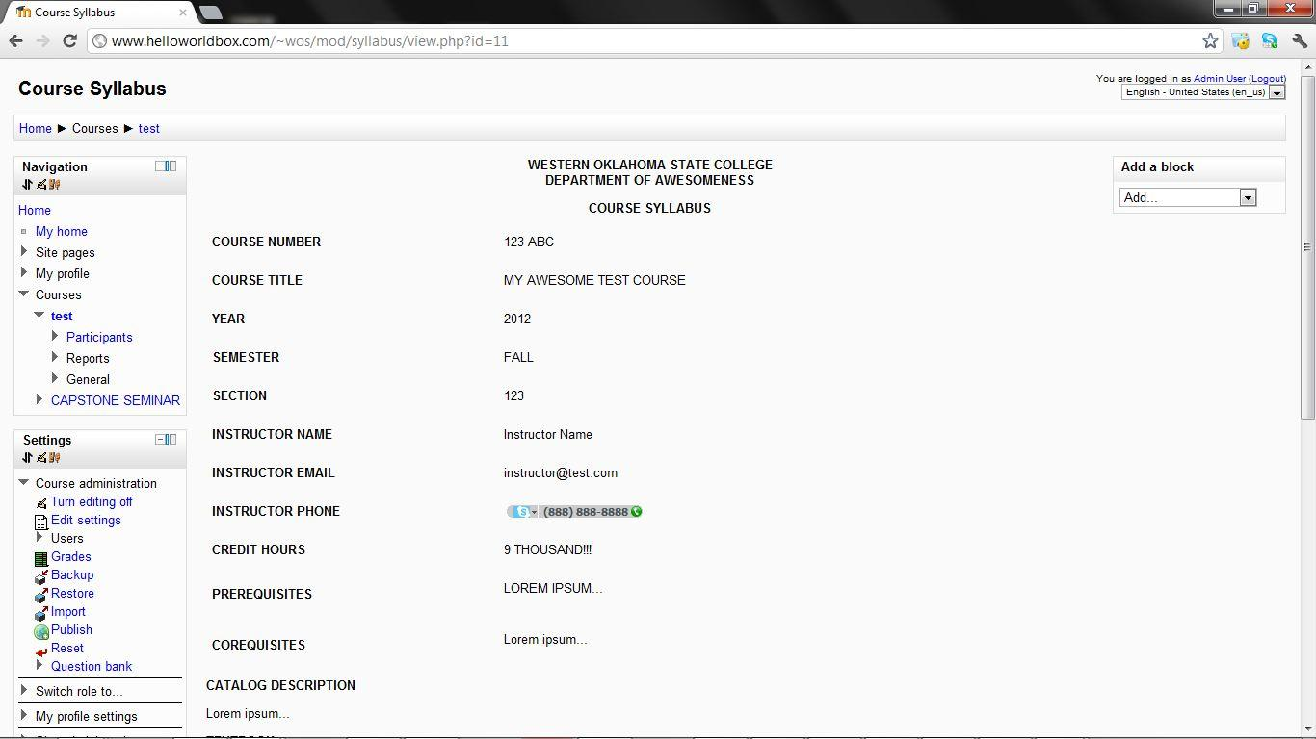
Step 8 cont'd

Slide 17
All done!

